Slide 1
What is Sharpen Herbicide?
 | Sharpen®
Active Ingredient: | saflufenacil
Mode of Action: | Cell membrane disruptor
Site of Action: | Group 14: PPO inhibitor
 | Broadleaf weed burndown Contact activity Limited soil residual activity

Slide 2
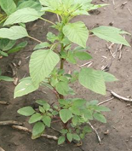
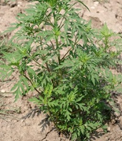
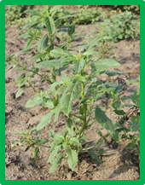
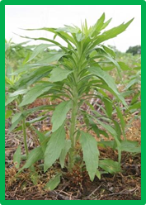
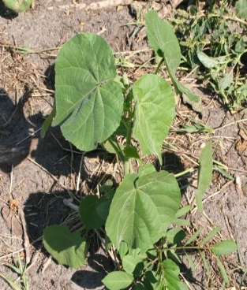
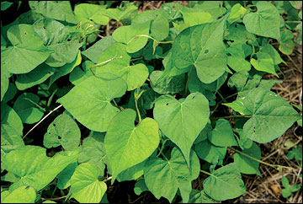
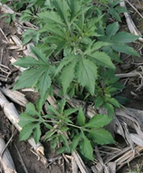
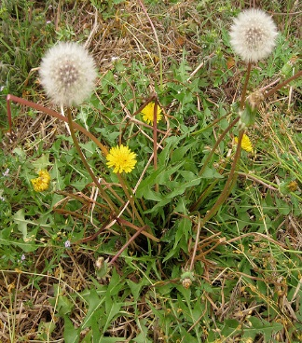
Sharpen Herbicide
Controls over 190 broadleaf weeds including Glyphosate Resistant
Palmer Amaranth
C. Ragweed
Waterhemp
Marestail
Velvetleaf
Morningglory
G. Ragweed
Dandelion
Performance you can depend on

Slide 3
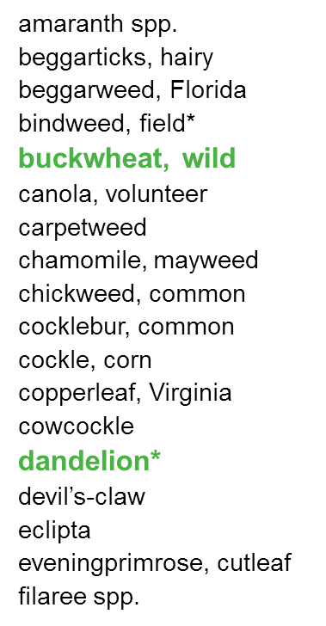
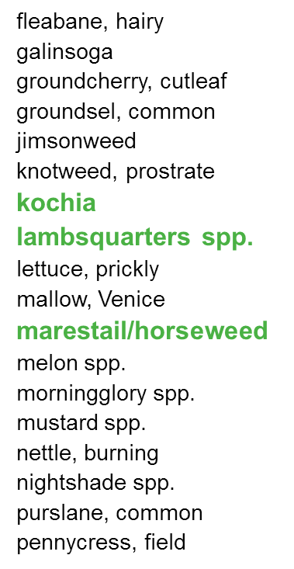
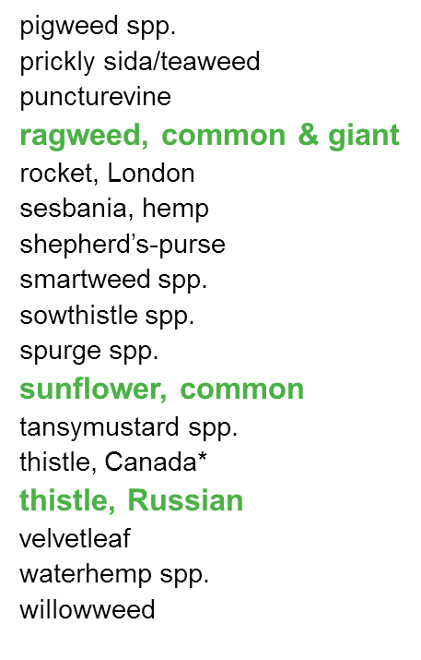
Sharpen controls the toughest broadleaf weeds….

Slide 4
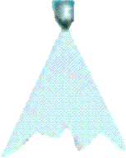
Sharpen® Herbicide for Alfalfa Burndown
Apply during dormancy in established stands only!
Apply to < 4 inches of growth
1.0 – 2.0 fl oz/A
+ MSO and UAN/AMS
28 day PHI
Signal word Caution; Paraquat products = Danger/Poison
Notes:
Seedling: maximum of 2.1 pints/A

Slide 5
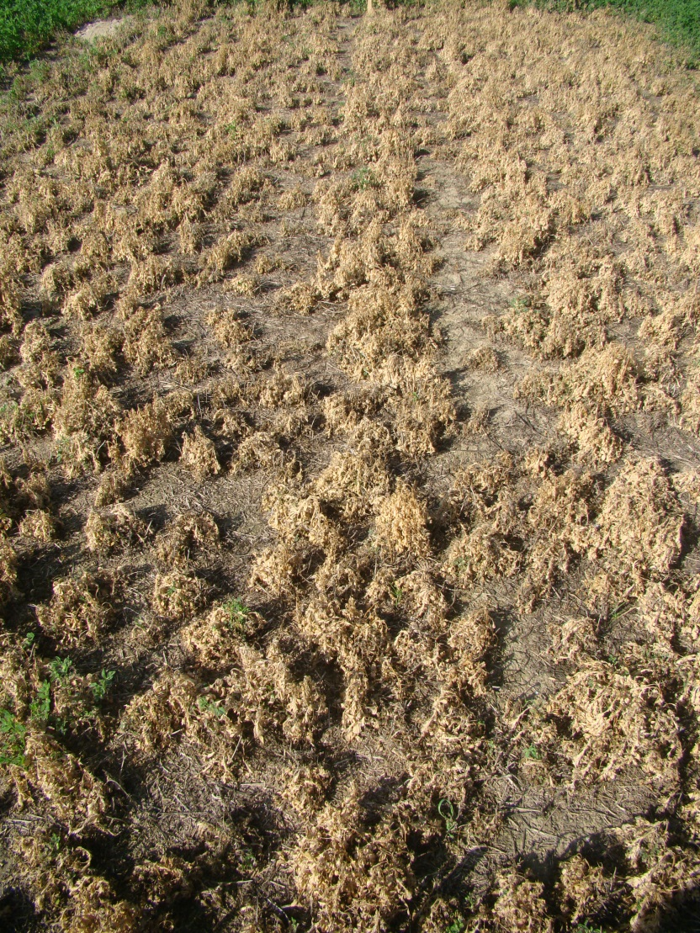
Early Feb. Application Gramoxone vs. Sharpen

